Slide 1
Embedded Systems Lab Prep 8
Introducing the EyeBot32

Slide 2
What Are the EyeBots32?
A small mobile robot (large palm size) built around the ESP32 microcontroller.
It features 3 PSDs, two motors with encoders, an onboard camera and an extensive software API to program it.
This API is called RoBIOS, and it hides the internal complexity of driving and sensing, allowing you to focus on bigger picture things.

Slide 3
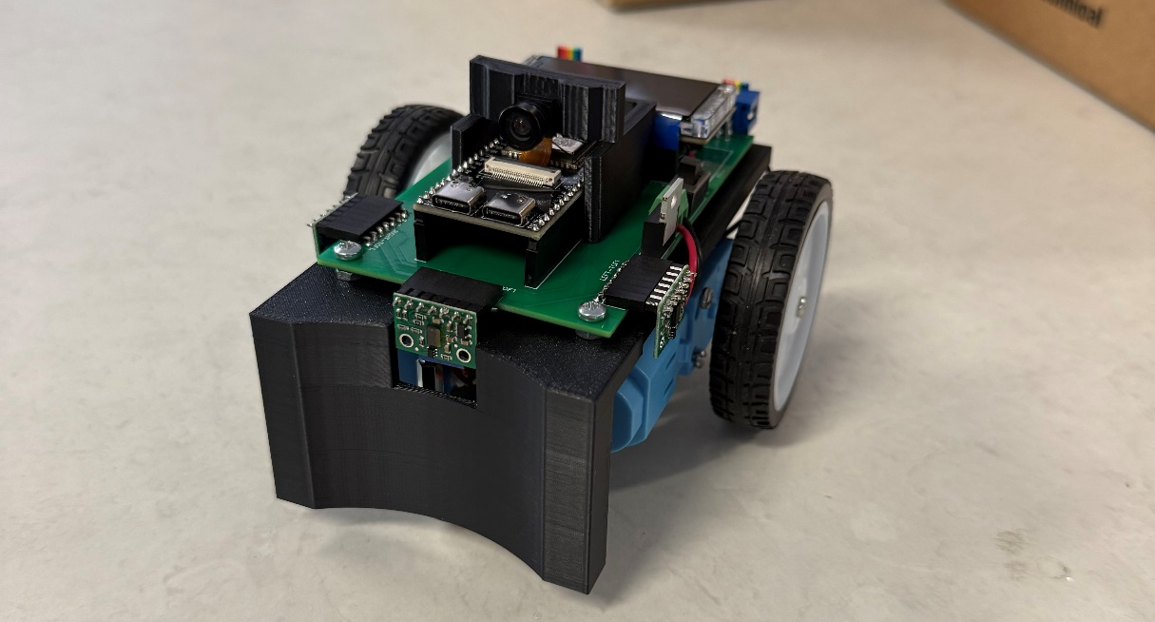
The EyeBot32

Slide 4
RoBIOS
This API splits the robot into the following parts:
LCD – text and simple graphics
CAM – Camera
IP - image processing functions
VW – “vehicle” motion primitives (auto PID)
MOTOR – direct wheel control and PID tuning
KEY – read the two onboard buttons
PSD – read front/left/right distance sensors in mm

Slide 5
Documentation
Everything covered here is written in detail in the User Manual.
This manual and all necessarily files for the EyeBot can be found on roblab: https://roblab.org/courses/embedded/EyeBot32/

Slide 6
Getting Started – Quirks and Tips
You will be provided with a Platformio project that already has all the necessary libraries installed.
All you need to do is add your code
You do not need to add includes for Arduino.h, TFT_eSPI.h or any other libraries needed by RoBIOS. This is handled in the eyebot header file, so all you need to include is eyebot.h
The RoBIOS API will initialize several things, this is done for you. However, it only does this at the first RoBIOS function call (not before). You may call eyebotStart() to force it to initialize.

Slide 7
Getting Started - Continued
You may upload code through USB while the batteries are turned off.
However, the robot has an onboard electrical safety check and will not run if you try to power it through the USB instead of the batteries.
A boot screen will run each time the RoBIOS API initializes. Check what it says to ensure everything initializes correctly.
If it doesn’t, follow the instructions and then refer to a facilitator if you still cannot fix the issue.

Slide 8
Functions
The real utility of RoBIOS is in the functions it exposes to you.
For these labs, you will mainly just need VW and PSD, which I will go over
You may need some functions from LCD so I will briefly go over that as well.
The functions are all quite self explanatory, and the manual provides a good explanation of each function.
Please use the RoBIOS functions, don’t try to implement stuff yourself (don’t use TFT_eSPI) as this will cause things to break.

Slide 9
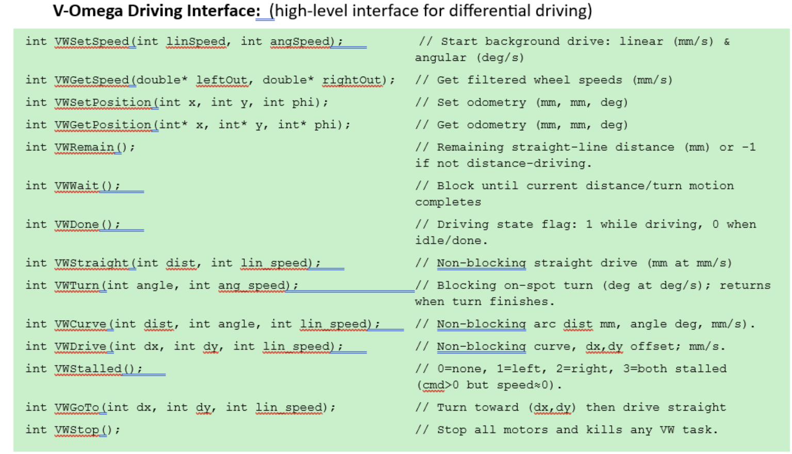
VW

Slide 10
Non-Blocking
Some of the VW functions are non-blocking
This means you code carries on while the task is being executed.
If you want to hold, you need to do it yourself.
Otherwise, you can go do other things while you move.

Slide 11
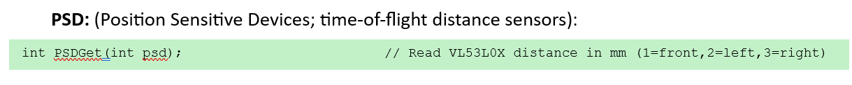
PSD
Instead of passing in a number, you may pass either of the following three constants:
PSD_FRONT, PSD_LEFT, PSD_RIGHT
These constants simply represent the integer number for the PSD.

Slide 12
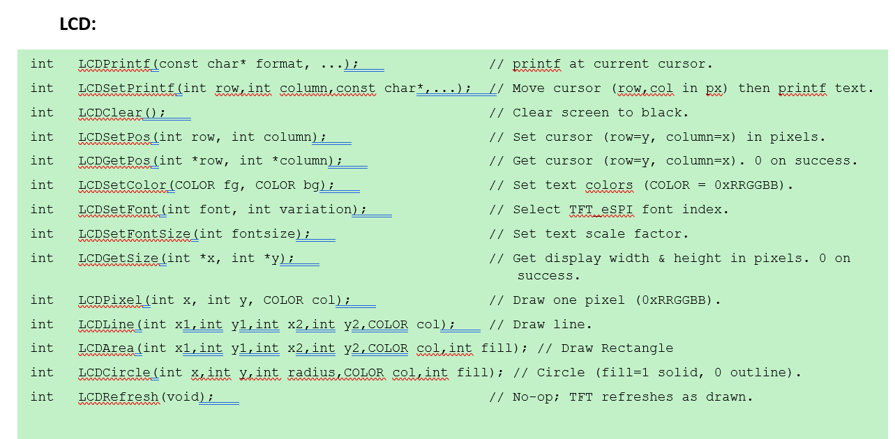
LCD
You do not need to create a TFT_eSPI object, the RoBIOS does this for you.

Slide 13
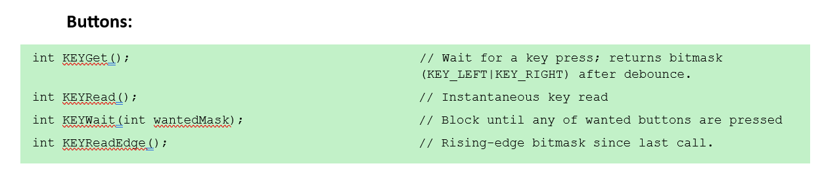
Buttons

Slide 14
Delay
vTaskDelay is the ideal method for doing a delay, instead of using Arduino’s delay() function.
This is because it works the best with FreeRTOS.
However, vTaskDelay is not in milliseconds, you must divide by portTICK_PERIOD_MS.
So if I wanted to delay 1500 ms, I would do:
vTaskDelay(1500 / portTICK_PERIOD_MS);

Slide 15
Tips for Completing the Lab
Dead reckoning is when you use the robot’s onboard encoders to determine where it has driven. This is often very inaccurate and not a good way to keep track of where you are.
For example, if you wish to drive around the edge of the driving area, you should not use dead reckoning to drive around the walls.
You should instead use your onboard sensors to localize and ensure you stay on course.

Slide 16
Tips for Completing the Lab Continued
A better way is to use a proportional controller for following a wall. Use the PSDs to track where you are.
Hint: there are several (at least two ways) to tell if your orientation is parallel to a wall or not.

Slide 17
Eyesim
Can be installed from here: https://roblab.org/eyesim/
Also uses RoBIOS, so all the exposed functions are the same as the ones on the EyeBot32 and work the same way too.
Follow the instructions to install.
It is a 3D simulator, and it is quite realistic so it is useful in determining whether your logic or ideas will work.
You are not obligated to use it, but it might be useful for you if you want to do some prep at home and test your code before the labs.

Slide 18
Videos
The labs are possible with the given robots as they have already been completed by Parham.
Think carefully about your algorithm works and how it localizes. Print data to the screen so you know what is going on.
If your robot isn’t navigating properly, it is likely because of your code or your logic.

