Slide 1
Embedded Systems Lab Prep 5
Serial, Servos and Project Info

Slide 2
Serial Communication
Serial in this context means one at a time, or one by one.
Serial communication is digital (not analogue) and sends one bit at a time.
You use serial communication to transmit data into or out of the ESP32 (to/from another ESP32 or a sensor).
There are different types, like UART, SPI, I2C etc.

Slide 3
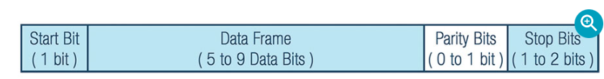
UART
Univeral Asynchronous Receiver Transmitter (UART).
Requires two lines between devices, Rx (receive) and Tx (transmit). Devices must share a common ground.
Data is sent bit by bit. Each byte is sent as a packet, which contains a start bit, the byte (8 bits), parity bits and then stop bits.
It is asynchronous, so they do not share a clock signal. Instead, both devices must agree in advance on the communication frequency
https://www.analog.com/en/resources/analog-dialogue/articles/uart-a-hardware-communication-protocol.html

Slide 4
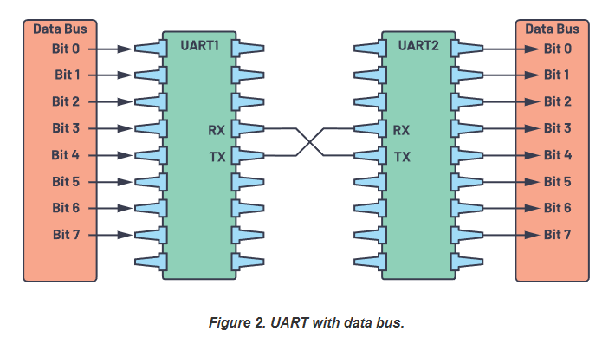
Wiring
Response
Secondary ESP32
Data
Main ESP32

Slide 5
ESP 32 Hardware Setup
You could use software to create or read UART signals (bit banging) but it’s not very good
The ESP32 has a dedicated UART chip, that can run up to 3 hardware serial comms/channels at once.
The UART chip uses a pin matrix which is why (unlike old Arduino boards) you can set whatever pins you want as Rx and Tx.
You may struggle to run more than 2 hardware serial connections as the ESP32 seemingly reserves the last one for USB communications

Slide 6


Software Implementation
Step 1; define the pins you will use.
Step 2; Start the serial communications
9600 is the baud rate or data rate, in bits per second
SERIAL_8N1 means we have a data frame of 8 bits, N for no parity bit and 1 for 1 stop bit.
You must use Serial1. If you wish to create another one, use Serial2.

Slide 7

Software Implementation Continued
The ESP32 will now fill a buffer in the background of incoming data. You can just periodically empty this buffer to read received data.
This example reads character by character.
The default buffer size is 256. If data comes in faster than you read it, the oldest values get overwritten. To fix this, either increase the buffer size or read faster.

Slide 8
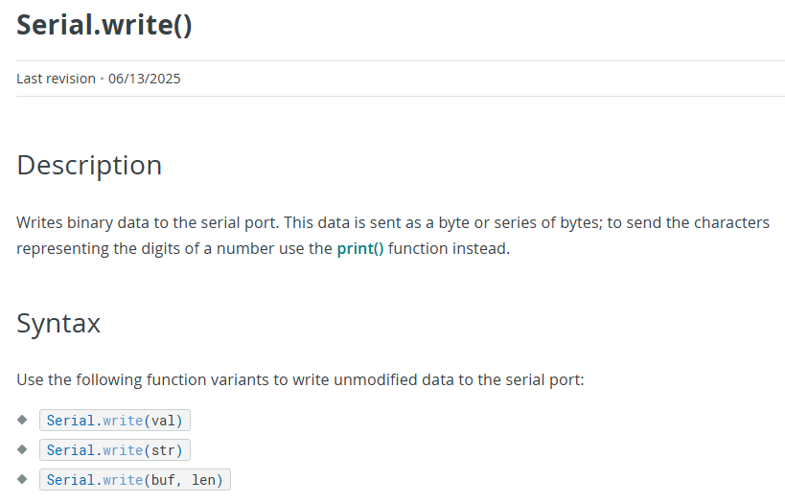
Software Implementation Continued
https://docs.arduino.cc/language-reference/en/functions/communication/serial/write/

Slide 9
Software Serial
You can install a software serial library to create additional UART channels.
As this is software serial (not hardware serial) it will bit bang the UART lines.
This is bad, but if you run no more than 9600 baud rate, and your sensor/device outputs little data, then it is a feasible solution to connect more UART devices

Slide 10

Sending Data to Terminal
You can send data to your laptop terminal (over USB). This also uses UART
To commence this communication, you use Serial and only specify the baud rate (no pins or packet type).
To print values to the terminal, use Serial.print(“some string”) or Serial.println(“some string”)

Slide 11
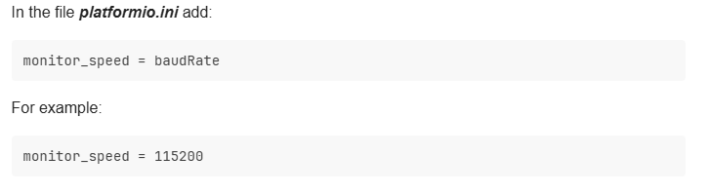
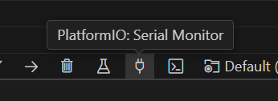
Laptop Side Setup
Your laptop must be on the same baud rate too
Go to your platformio.ini file.
Then open the Serial monitor to see data being sent from the ESP32
https://community.platformio.org/t/serial-monitor-baudrate/5837

Slide 12
Speed Considerations
This may not matter for your project or this unit, but processor speed may become an issue in projects you work on in the future.
Communication is often where a lot of time is lost, sensors not updating fast enough, using slow communication protocols, programming communication in inefficient ways.
If you are not careful you can run into issues here.

Slide 13
Speed and considerations
UART is fairly slow, it is the slowest serial protocol
9600 bits per second is very slow but can be improved by increasing baud rate (however, not all sensors support this!).
Try to avoid UART where you can, use I2C if possible.
Try to use higher baud rates if possible, cycle time matters and this will help reduce it.
But, baud rate is not a guarantee of data quantity. Increasing baud rate does not necessarily increase sensor refresh rate. Devices are not required to constantly output bits, some devices only output data when they refresh periodically (not constantly).

Slide 14
Cycle time – in the context of the project
The cycle time (time for one run of the main loop to execute) of the Arduino depends on how you have programmed. It takes as long as it takes the ESP32 to execute all tasks
You need to ensure your cycle time is not too slow, if the main loop is running at 1Hz, your sumo robot will not have fast enough reflexes to win/perform well.
Bad or inefficient code is a big way to waste time, but more commonly is using blocking functions when they shouldn’t be used or poor communication

Slide 15
Blocking Functions
Some functions are blocking, like delay(millis).
Blocking means the function stops the CPU/execution until it completes.
For example, delay will hang the entire program for the specified time. You should almost never do this, as time is expensive and you want to use the CPU as much as you can.
Serial.write and Serial.read are somewhat blocking. It depends on how full the buffers are.
Avoid using Serial.print during true runtime, no need and can cause lag.

Slide 16
Poor Communication – waiting too long
If you handle your communication poorly, you can lag your cycle time for no reason.
For example, some libraries program “blocking” sensor reads. The ESP32 just sits at the UART line and waits to receive a full sensor packet.
This is ok if the packet is small, baud rate is high and sensor refresh rate is high. But often it’s not, if your sensor refreshes at 10Hz, you are wasting 100ms each time even if it only takes 5ms to actually process data.
The better way, empty the buffers constantly, process data constantly and use flags to let the ESP32 when fresh data has arrived (don’t sit there waiting for the new packet to come in).

Slide 17
Poor Communication - processing too slow
Consider instead that refresh rate is high, but each sensor read outputs is very big (lots of serial data sent over).
Don’t just fill the buffer with the whole serial data and then process in one go (this causes you to have intermittent long and slow loops, not ideal).
Empty the buffer and process the data constantly, so you process a bit of data each cycle, rather than one big chunk of data in one cycle.
This spreads the time spent processing across multiple cycles, keeping the cycle short (instead of having one big cycle).
But you likely won’t need to deal with this for the project, as you won’t use those sensors and they have better libraries.

Slide 18
Sensor Choice
So when you consider what sensors to use, you have multiple things to thing about
Cost
Is the data the sensor provides useful for your application? For example, you won’t need a humidity sensor but you will likely need a distance sensor.
Communication protocol – if you use too many UART devices you will run out
Sensor refresh rate – no good if your distance sensor refreshes every 5 seconds.
Communication speed – if your cycle time is already limited, you may not wish to use a slower device

Slide 19
Ultrasonic Sensor vs PSD
Ultrasonic sensor and PSD both measure distance
PSD is analogue, so they can be inaccurate as it can be tricky to create a good lookup table
Ultrasonic sensor is not analogue, nor does it use UART. Very simple to use, no calibration required and accurate from the beginning.
However, the ultrasonic sensor is blocking while the PSD is not, so there is a tradeoff (accuracy vs speed).
There are other solutions, use an extra ESP32 to handle the ultrasonic sensor and then just send the data over UART (main ESP32 is not blocked, and very small data is sent across so communication speed is non-issue).

Slide 20
Final Note
You shouldn’t worry too much, your robot is likely not that complicated, nor does it need to run very fast
The information here is more relevant for other projects where speed is important, and now you are better equipped to understand this and create more efficient systems.
Nonethless, you should still at the very least consider cycle time at a basic level, if your sumo robot has a 1 second cycle time or if your sensors are too slow to update, you may struggle against fast robots.

Slide 21
PWM
Sidenote – do not bit bang your PWM
You may have done this in the lab or encouraged to do this in the lab, because it is simple and a good way to learn about PWM
But for real applications, it is a bad way to do it. Use LEDC or a hardware PWM library that utilises the ESP32s built in hardware PWM generators.
Servo PWM duty cycles are very short, in more complicated code you may not be able to guarantee your cycle time is fast enough to bit bang
Even then, the timing will still not be as good as using dedicated hardware

