Slide 1
Embedded Systems Lab Prep 5
Actuators and Sensors

Slide 2
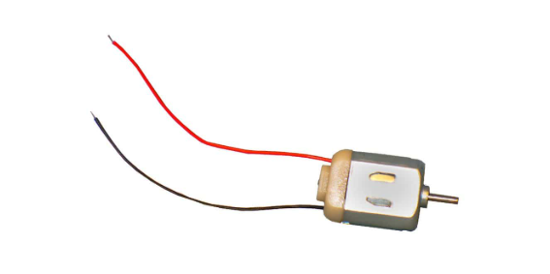
How Do DC Motors Work?
DC motors simply rotate at a shaft continuously at varying speeds
Applying a current causes the motor to spin
There is a proportional relationship between the applied voltage and the velocity.
Voltage will also affect the torque, typically higher voltage results in higher current and more torque

Slide 3
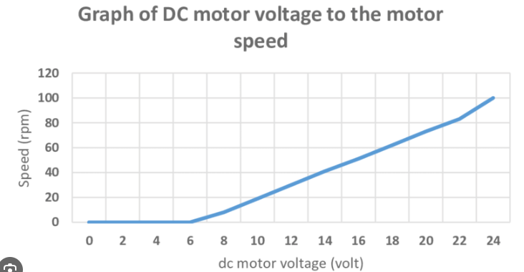
Velocity changes with Voltage

Slide 4
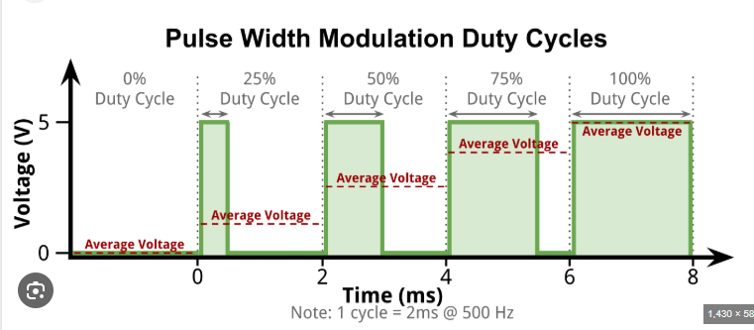
ESP32
An analogue output would allow you to vary output voltage
The ESP32 cannot do this, it can only output 0 or 3.3V as the logic voltage is 3.3V
You use PWM (pulse-width-modulation) to simulate analogue. Change the voltage by changing the duty cycle.
The analogue voltage is the average voltage of the PWM.

Slide 5
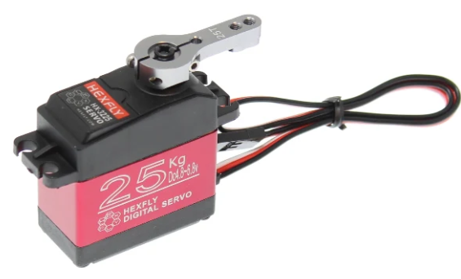
Servos
Servos rotate a shaft to precise orientations. They cannot rotate past a certain limit (typically 180 degrees).
The servo speed is also fixed
Applying a PWM signal will change the orientation of the servo

Slide 6
Servo PWM
Servos require a specific PWM signal
Typical pulse frequency is 50Hz, or 20ms
The duty cycle must be normally be in the range of 1000-2000ms. Some servos accept slightly less or slightly more, it depends on the servo
The duty cycle is linearly mapped to the servo orientation. 1000 is the minimum orientation, 2000 is maximum and anything in between sets to an angle in between

Slide 7
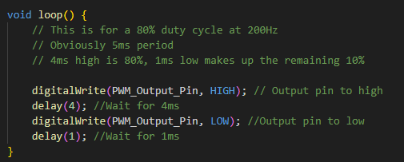
How do we do PWM On An ESP32?
Program it ourselves:
But it’s blocking, so that’s bad.
Better way is to use build in function

Slide 8
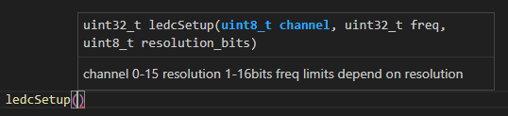
LED Control
LEDC (LED Control) was built for controlling LEDs, but it does so using PWM, so it can be used for servos and motors too.
First step is to initialize the channel with a given frequency and certain resolution
Resolution is the range (how finite) you can specify, 8 bits = 256 values, 16 bits = 65,536

Slide 9


LED Control
Second step is to attach a pin to the channel
Third step is to set write the duty cycle to the channel
You cannot exceed your chosen resolution
Less bits is simpler, but sometimes not enough control (8 bits it will not work with servos, duty cycle is too small).

Slide 10
Reading Pontetiometers
A potentiometer is a resistor with varying resistance.
It has three pins, two for power and ground, and one for signal.
The dial can only rotate in a finite number of angles (around 180-360 degrees, not continuously), and it allows you to measure the precise angle it is at.
The voltage on the signal line changes proportionally with how much you have rotated the dial (basically the opposite of a servo).

Slide 11

AnalogRead()
Use this function to check voltage at a pin
It outputs a value from 0 to 255, not a voltage.
This doesn’t really matter, just spin your potentiometer and check what the minimum and maximum values are, and you can map it how you want from there
Now you know how far the potentiometer has rotated!

Slide 12
Position Sensitive Device (PSD)
These measure distance.
We are using analogue ones, so the output is again from 0 to 1024.
Also not a voltage, but it doesn’t matter as you will generate your own lookup table.
Just take measurements in 5cm increments to generate your lookup table.
You can then use the lookup table to find the distance the PSD reads from its output.
Solution 3 will go over creating a lookup table and how to interpolate from it.

Slide 13
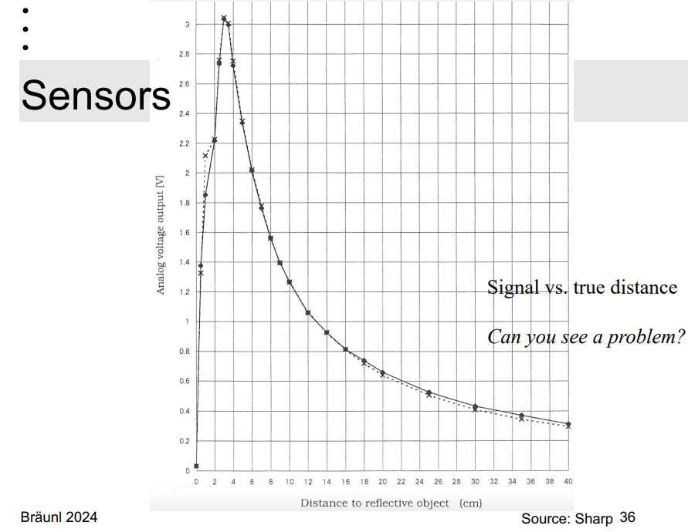
Example Graph of a PSD Output

Slide 14
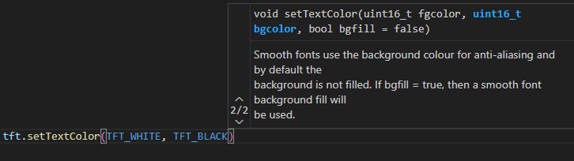
Stop Screen Flickering
I was wrong ☹ - stopping flickering is easy
You can set text to also have a background
Set your whole screen to black, set your text background to black and then set your text background to white.
Don’t clear the screen anymore, your new text will overwrite the old text with no issues since the background will clear old text.
You must do this in your labs – no more flickering.

Slide 15
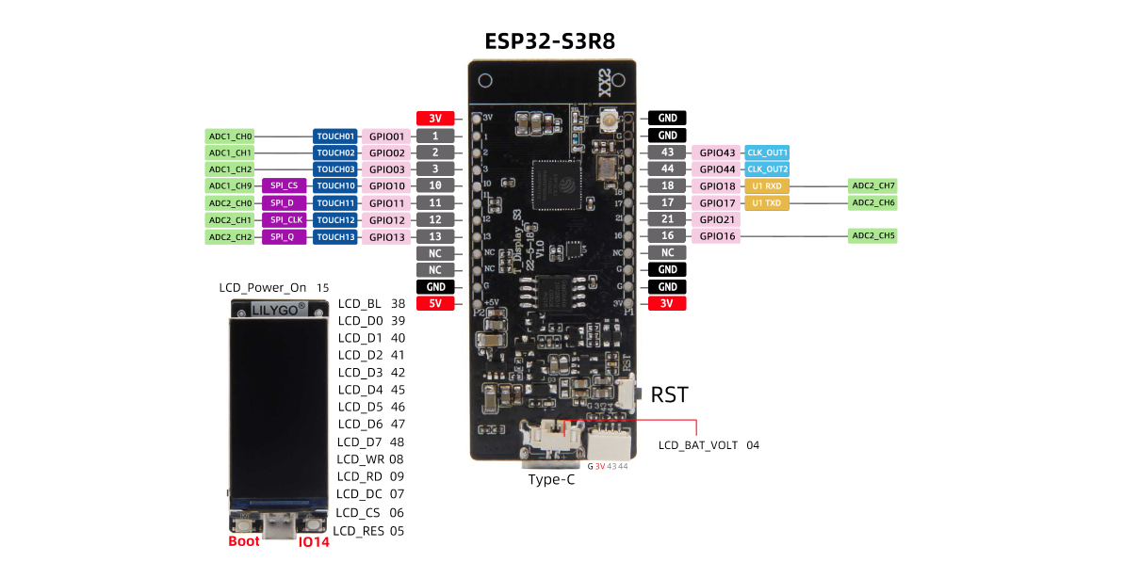
ESP 32 Pinout
You must use this diagram: https://github.com/Xinyuan-LilyGO/T-Display-S3/blob/main/image/T-DISPLAY-S3.jpg

Slide 16
Lab Task 1 – Draw the Wave
You need to print the high and low values to the screen
You don’t need to draw the graph, but it would be beneficial if you did this anyway.
You will need to draw the graph for the PID lab, it will be much better for you if you get ahead now!

Slide 17
PSD – Minimum Distance and Accuracy
Make sure you only measure at least 60mm away from the PSDs.
They throw erroneous values if you are too close.
For the lab, you may choose to implement a lookup table and interpolation. Either way you need to have a bit of accuracy in your results.

Slide 18
WARNING
If you work in pairs, you both need to do the work.
You will be asked to explain the code, if your partner wrote it and you don’t understand it, you will not be allowed to leave with your mark until you can explain it.
You will also be asked to explain the code, to check if you used ChatGPT or if you copied from the internet. If you cannot explain the code, you will receive a 0 on it and will need to start again and write your own code properly
Also bring a ruler to the lab (for the PSD).

Slide 19

Some extra stuff
Go over debugger
Go over Serial printing

