Slide 1
Embedded Systems Lab Prep 3
Building Circuits

Slide 2
What is the Goal of the Lab?
https://roblab.org/courses/embedded/labs/lab03-H-adder.pdf
You’ll get NOR and NAND chips, FLIP FLOP Chips, Adder Chips and DIP Switches, LEDs and Resistors
You need to connect them to implement what the lab sheet says.
You must do exactly what the lab sheet says, you cannot make your own changes.

Slide 3
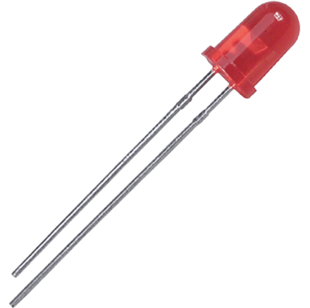
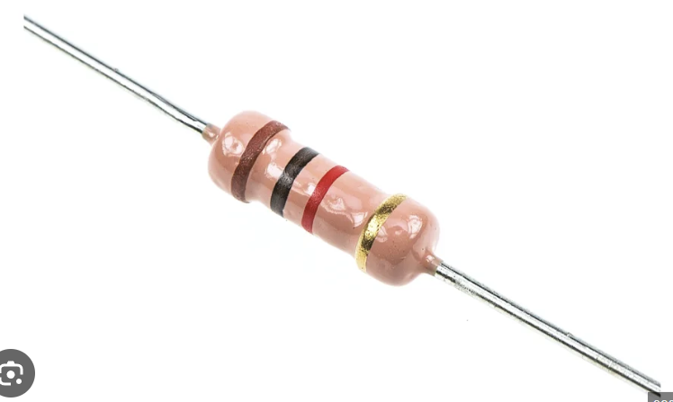
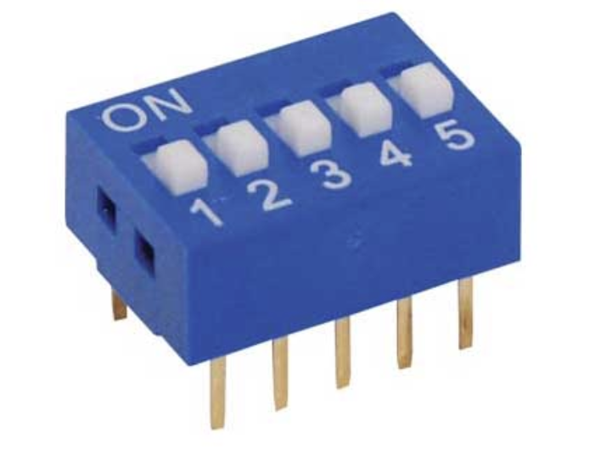
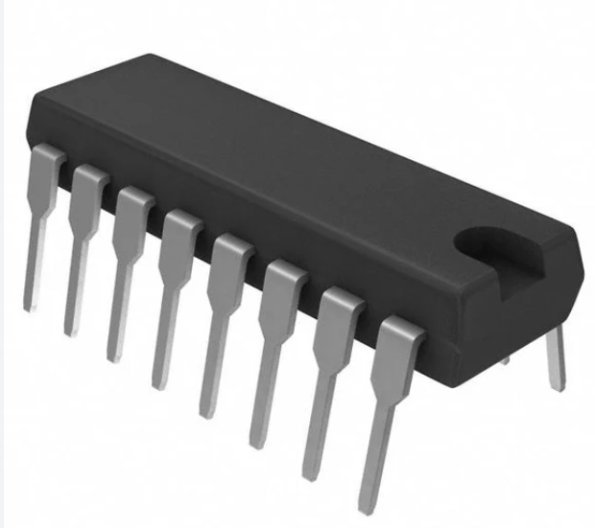
Components

Slide 4
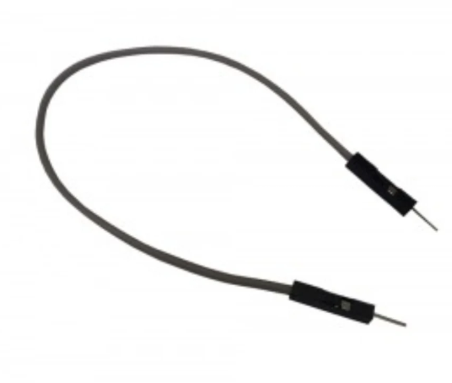
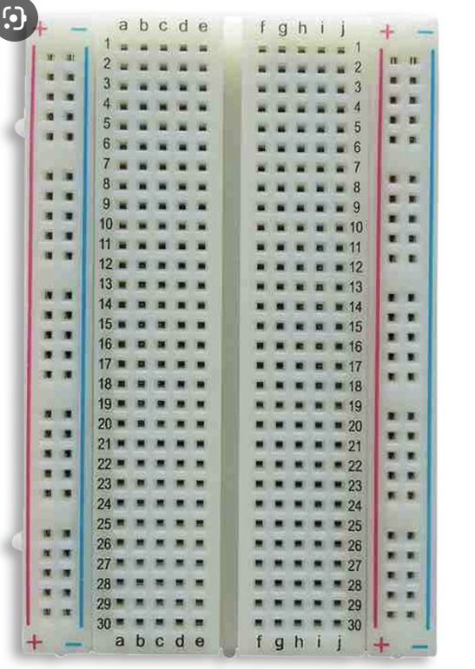
How do we connect the components?

Slide 5
DIP Switches
Made up of several “circuits”. Each circuit has a switch, that allows you to open and close it.
When the DIP switch is off (0) it opens the circuit, which leaves the input at floating. As such, you must implement a pullup or pulldown resistor (avoid floating states).
Polarity doesn’t matter

Slide 6
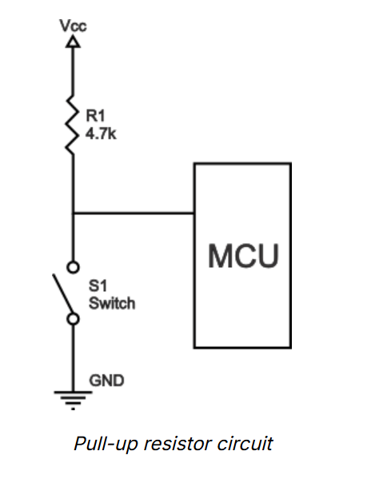
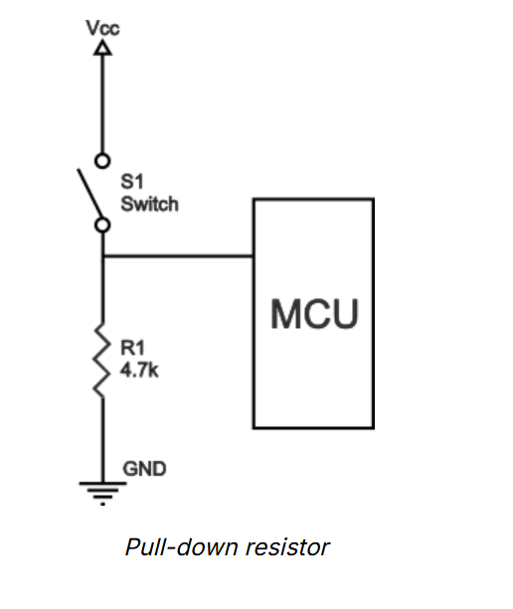
Pull up and pull down resistor
MCU = Microcontroller Unit. The input pin on the MCU is like a voltmeter, it reads relative to ground, so at no voltage, difference is 0 and we read 0 (low). When voltage comes in, say 5V, voltage difference is 5, and so we read 1 (high). Any high resistance resistor will do.

Slide 7
LEDs
Polarity matters, it’s a diode so current can’t flow if it’s the wrong way around.
Longer leg is the positive side, connect to +, the shorter leg is the negative side, connect to –
You must use a resistor or else you will blow up the LED. You need to limit the current (and voltage). Use 330ohm resistor (standard).

Slide 8
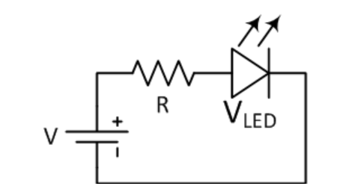
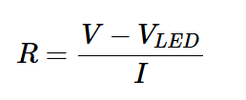
How do we find the resistor for an LED?
330 ohm is standard and a good starting point.
But you can calculate the correct resistance value. You do this based on the voltage drop you want across the resistor and the current you want the circuit to operate at.

Slide 9
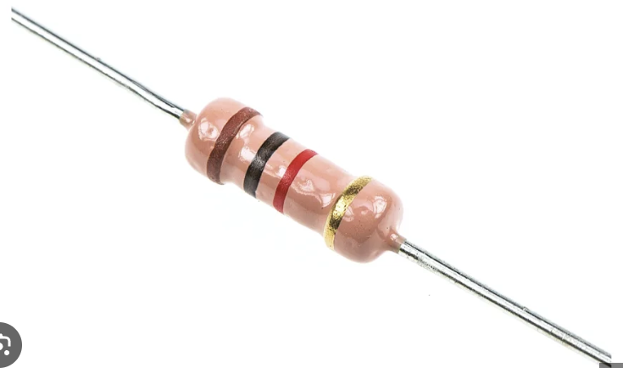
Resistor
Polarity doesn’t matter
Restrict current flow – 5V Arduino output is always 5V, so at little resistance, it can draw big current and break things.
Resistor will introduce resistance, which decreases current flow (V = IR).

Slide 10
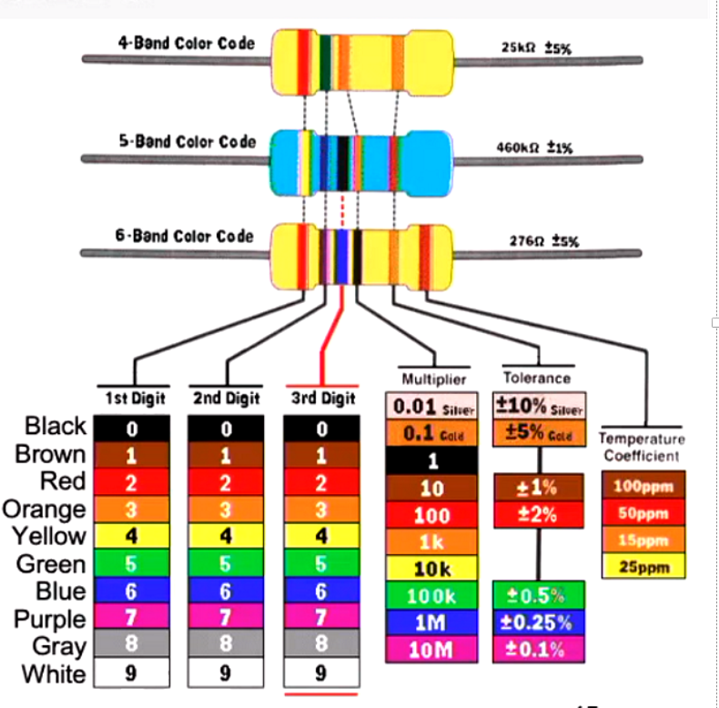
How to determine resistance
But it’s way easier to use a multimeter

Slide 11
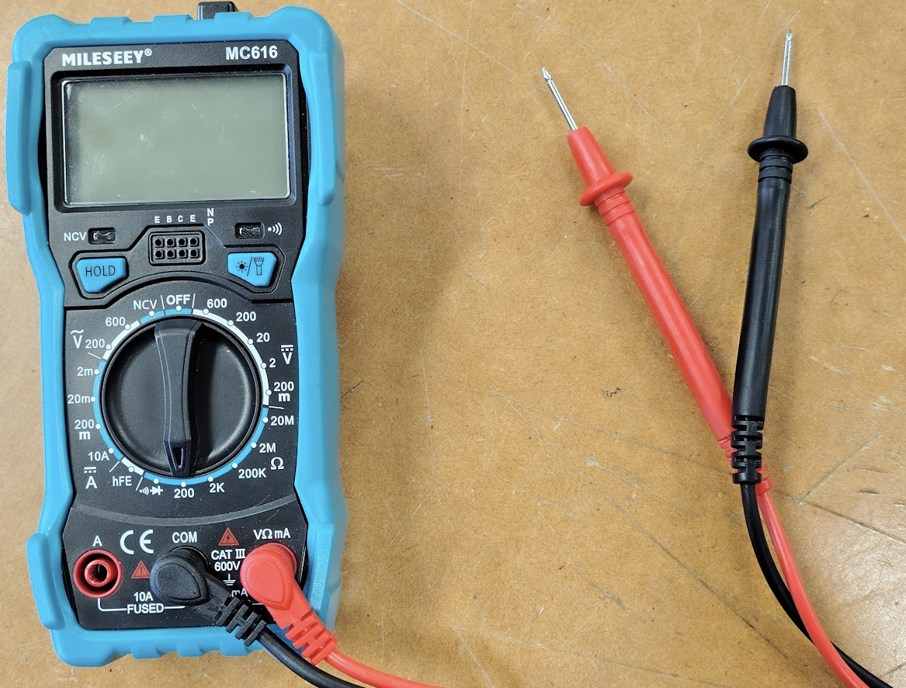
How to use multimeters
Check continuity across the whole circuit before running it.

Slide 12
Datasheets
You will need to read the datasheets to understand how the components work.
This is very important, if you don’t understand the chip, you won’t know how to wire it up and so how to complete the lab.
Datasheets can be found here (lab sheet link is broken): https://roblab.org/courses/embedded/datasheets/

Slide 13
NOR Example and Adder Example
ZC4001 NOR
https://roblab.org/courses/embedded/datasheets/ZC4001-NOR.pdf
74HC283 Adder
https://roblab.org/courses/embedded/datasheets/74HC4511-7SegmentBSD.pdf
You must power all chips, connecting both VCC and VDD (voltage and ground).
You must orient the chip correctly

Slide 14
Important Lab Info
All chips are tested at the start and end. You lose 1 mark for each chip you break/blow up.
Facilitator must check your circuit before you power it on so you don’t blow it up
You can bring your own kit to do the lab (breadboard, duPont etc), but you cannot complete the lab at home. You must build your circuit from scratch in class.
Use your multimeter to check your circuit if it doesn’t work, debug it (go through it step by step and find the fault).

Slide 15
Tinkercad for Preparation
You can choose to complete the lab at home in tinkercad to learn a bit about wiring and electronics.
Note the chips are a bit difference in tinkercad, you can’t copy your real circuit exactly as what you do in tinkercad (but it’s still good to do for the learnings).

Slide 16
Lab Preparation
You can’t do the lab physically from home
But make sure you understand how breadboards work and how you would wire everything. Use tinkercad for this, read the adder and gate chip datasheets and implement the lab on tinkercad.
Make sure you understand the difference between the tinkercad chips and the chips we use, and then come into the lab and wire up your modified tinkercad circuit.
The hard part of the lab is figuring out what wires into what. If you aren’t careful you could blow stuff up. Spend some time in tinkercad or just brainstorming and figure out your wiring.

